Slide 1

Predicting Real-estate Price in Riyadh
Prepared by :
Amal Alshahrani
Shahad Atte

Slide 2
Saudi Arabia’s residential real estate market, in the future , we expected there will be a rising demand for housing units. • It is a non-stable market that attempts to grow or fall periodically. • Non-stable market and prices are very dynamic
Our goal :Develop a model to predict housing prices in across Riyadh’s District

Slide 3
Tools used :
Python manipulation, Visualization ML libraries
Jupiter notebook

Slide 4
Stages :
Web Scraping
Data Preprocessing (EDA)
Modeling
Model Evaluation

Slide 5
Data Description
Real-estate type: VILLAs at Riyadh
Size of Extracted data: 1981 rows & 6 columns/features
We have gathered the data scrapped from the sources below :
Data source:
- www.sa.aqar.fm and
https://www.propertyfinder.sa/ and بروبرتي فايندر موقع العقارات الرائد في السعودية. الرياض - جدة (propertyfinder.sa)

Slide 6
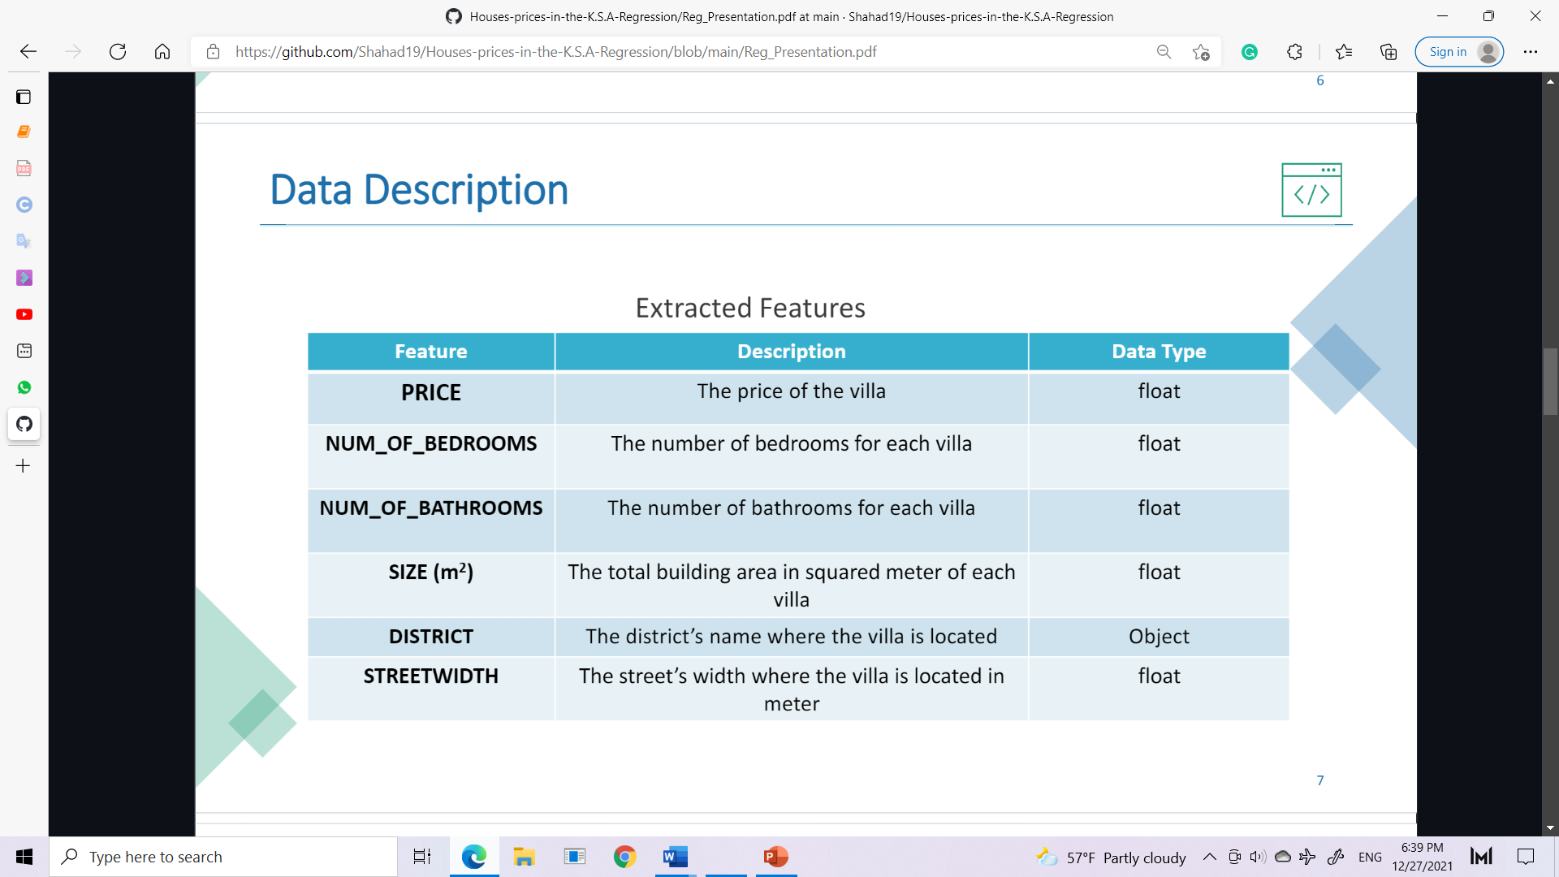

Slide 7
Data Pre-processing and EDA :
1- Data cleaning
• Ensure data frame are of the same lengths.
• Remove unnecessary words from the “district” feature such as “حي ". •
Remove “ م 2” from area (size(m2 )) data list. Fill nulls “Street Width” with the zero values .
• Filter data only in Riyadh city
• Check nulls to ensure data properly cleaned.
• Converting categorical values to numerical

Slide 8
EDA
• the "Size" feature has high positive correlation 0.67 with our target "Price“.
• - The "Num_Of_Bathrooms" feature has positive correlation 0.33 with our target "Price“.
• The "Num_Of_Bedrooms" feature has low positive correlation 0.037 with our target "Price

Slide 9
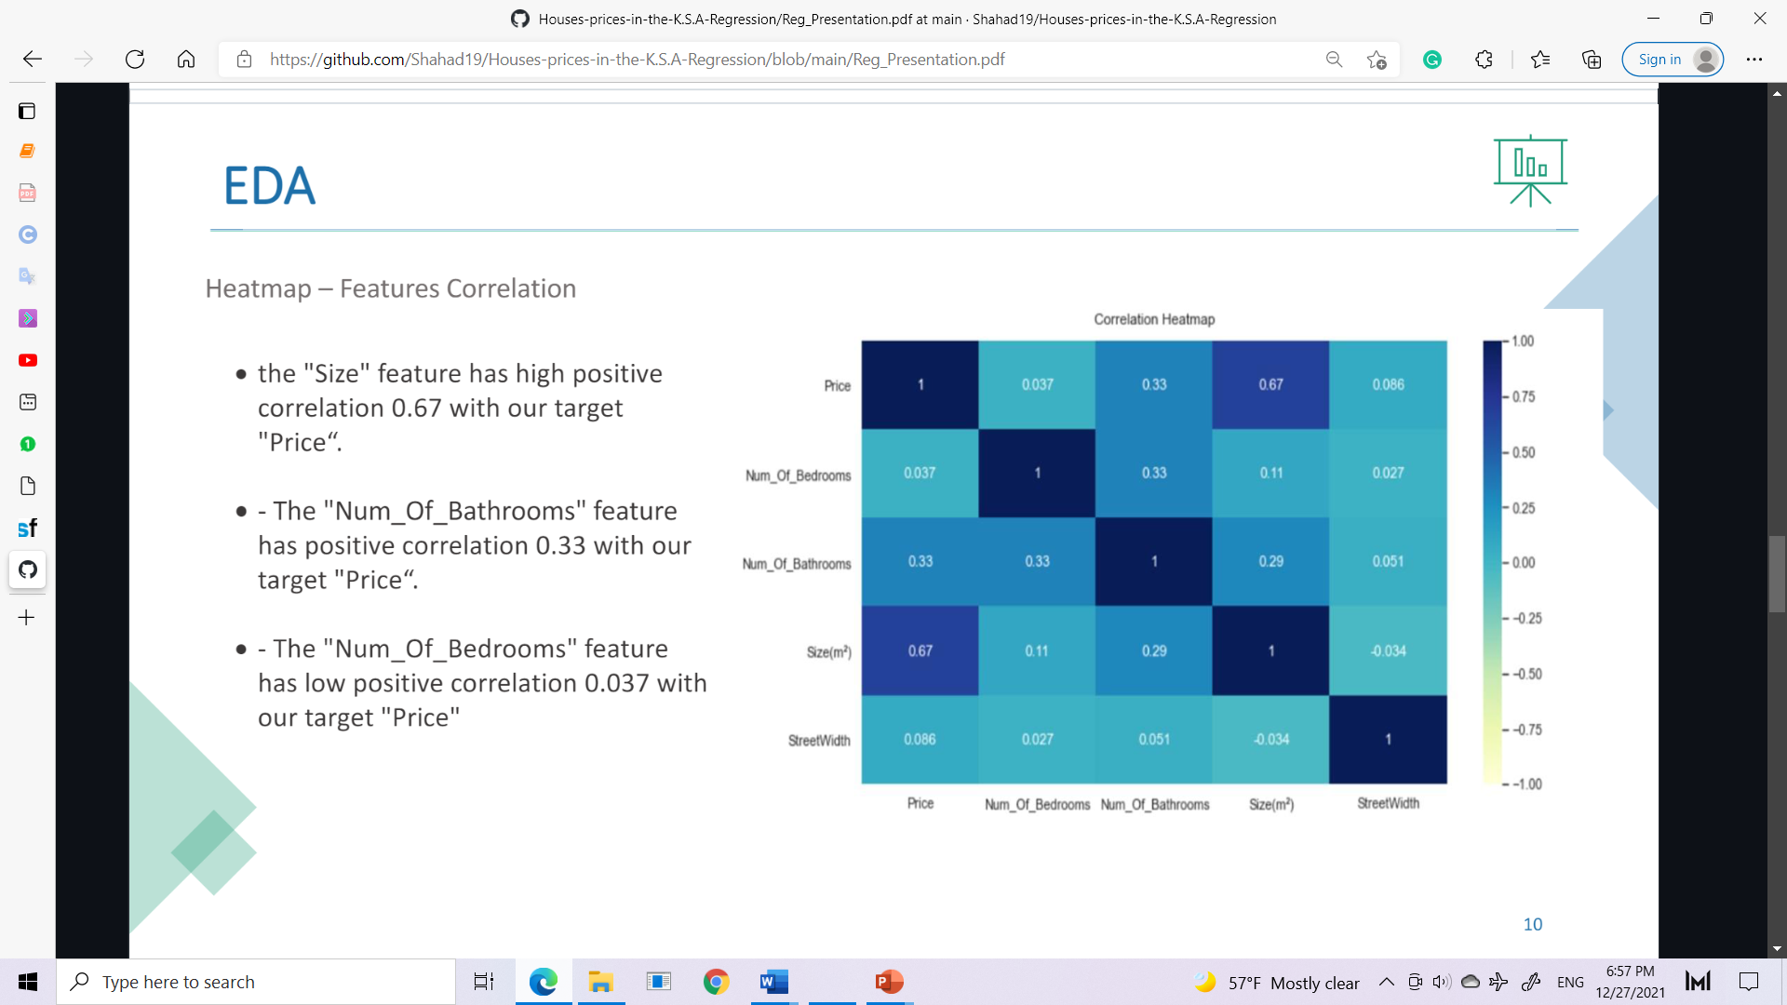

Slide 10
Modeling and Evaluation
• Split data: data split into 3 portions: 60% for training, 20% for validation, 20% for final testing evaluation
• Preprocessing: Convert “District” feature to dummy variables:

Slide 11
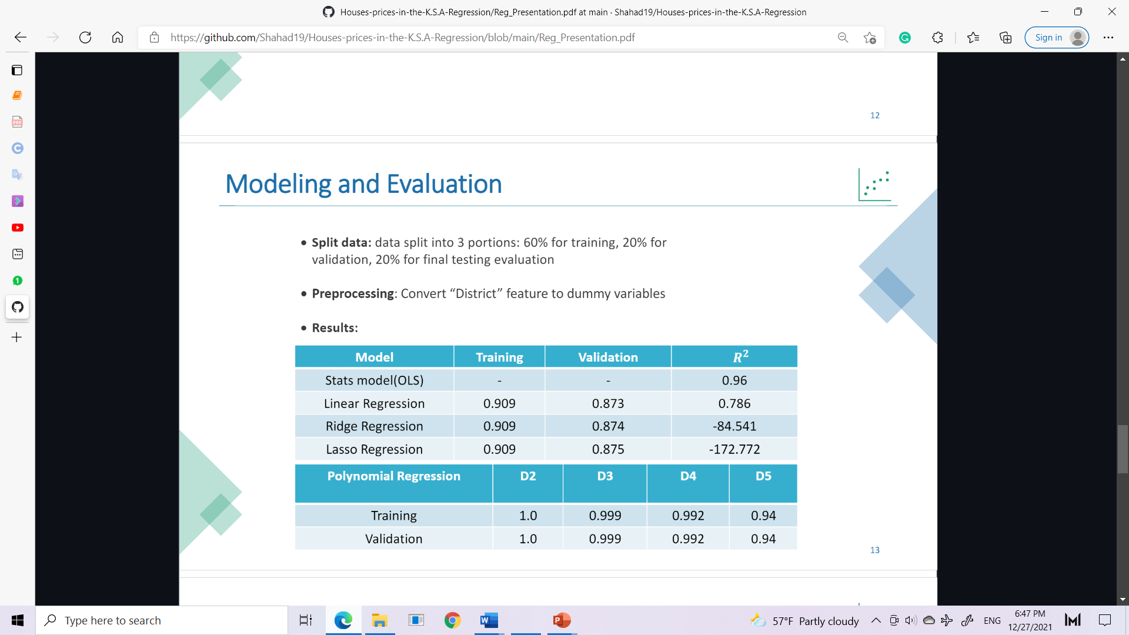

Slide 12
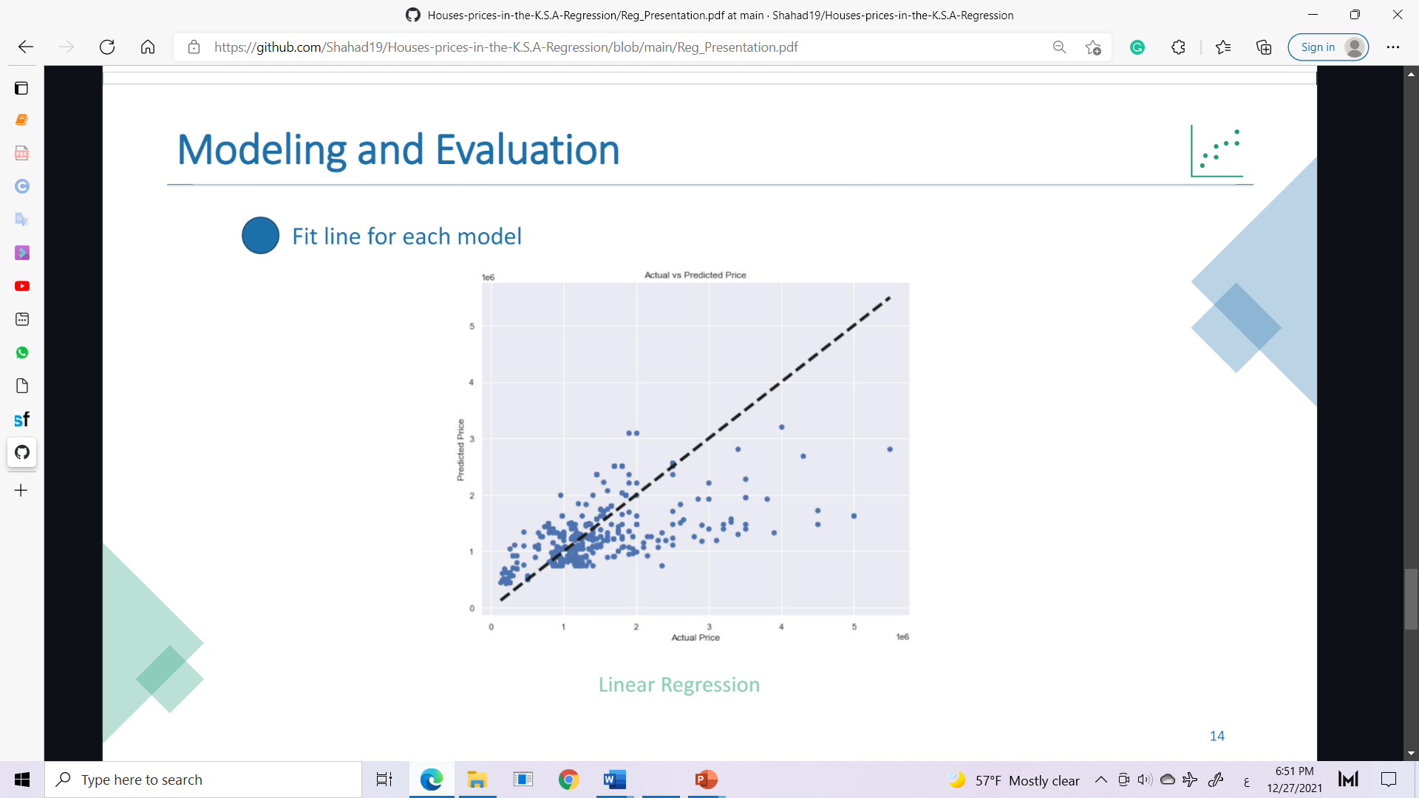

Slide 13
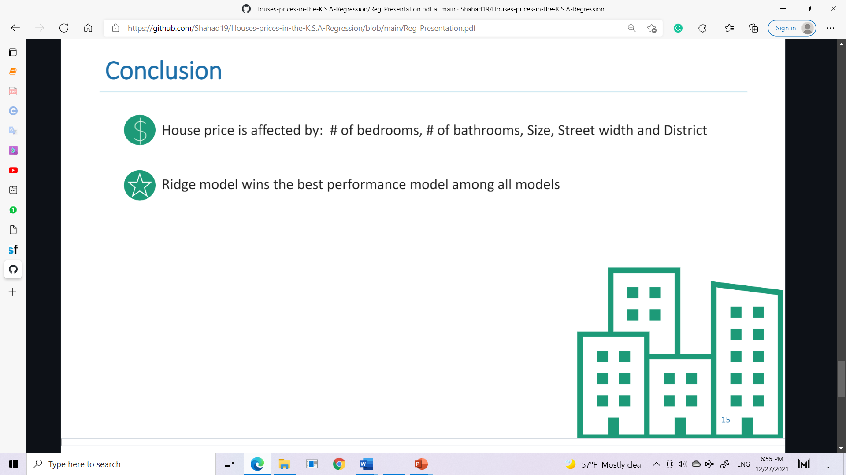

Slide 14
THANK YOU !

